Slide 1
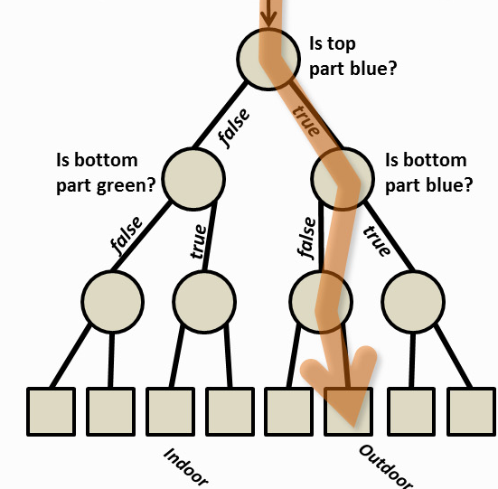

Decision Trees and
Random Forests
Dr. Debdoot Sheet
Assistant Professor
Department of Electrical Engineering
Indian Institute of Technology Kharagpur
www.facweb.iitkgp.ernet.in/~debdoot/

Slide 2
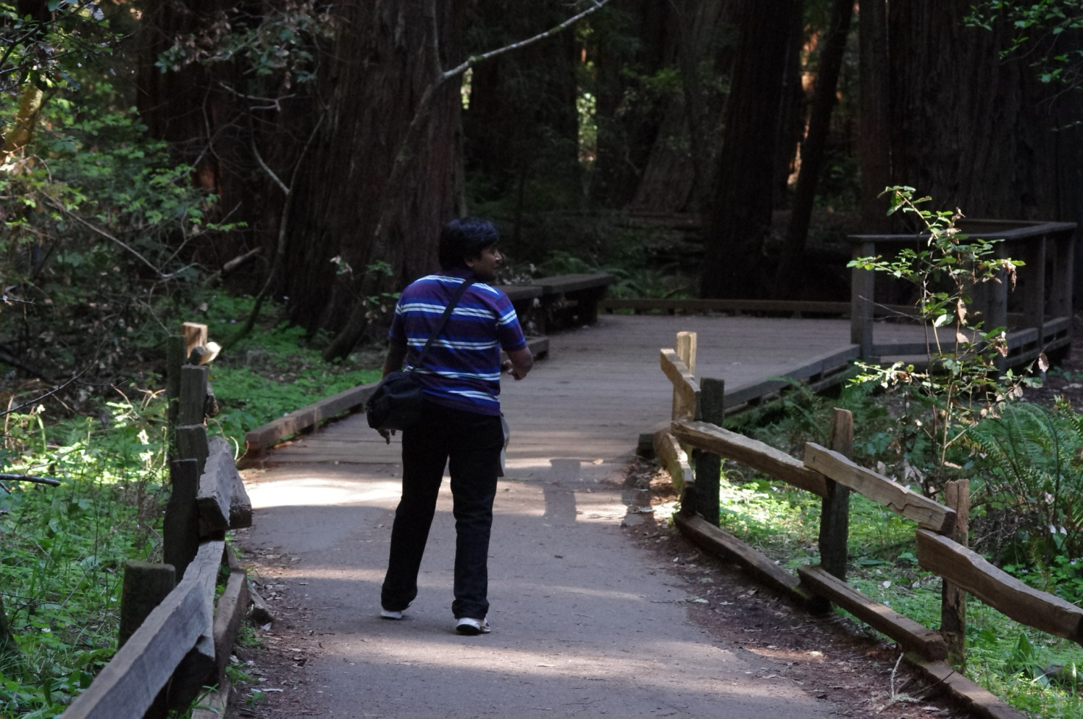
NOT ABOUT WALKING IN A FOREST

Slide 3
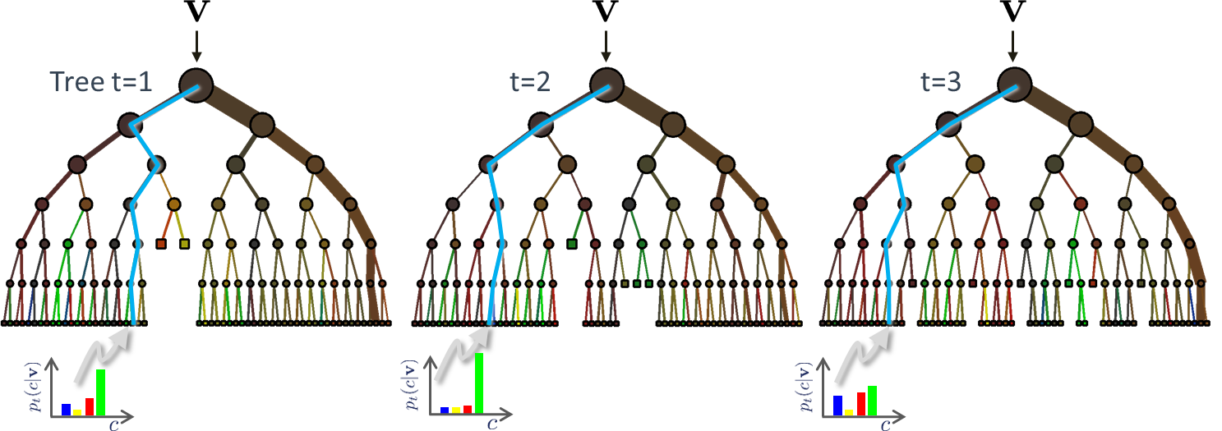
IS ALL ABOUT

Slide 4
Overview
Historical Perspective
Decision Tree
Random Forest
Application Scenarios
Computational Complexity
Variable Importance
What’s hot about them in ML Research?

Slide 5
Historical Perspective
Decision Trees
Random Forests
L. Breiman, J. Friedman, C. J. Stone, and R. A. Olshen, Classification and Regression Trees. Chapman and Hall/CRC (SIAM), 1984.
J. R. Quinlan, C4.5: Programs for Machine Learning. 1993.
Y. Amit and D. Geman., “Shape quantization and recognition with randomized trees,” Neural Computation, vol. 9, pp. 1545–1588, 1997.
T. K. Ho, “The random subspace method for constructing decision forests,” IEEE T-PAMI, vol. 20, no. 8, pp. 832–844, 1998.
L. Breiman, “Random forests,” Machine Learning, vol. 45, no. 1, pp. 5–32, 2001.

Slide 6
Decision Tree

Slide 7
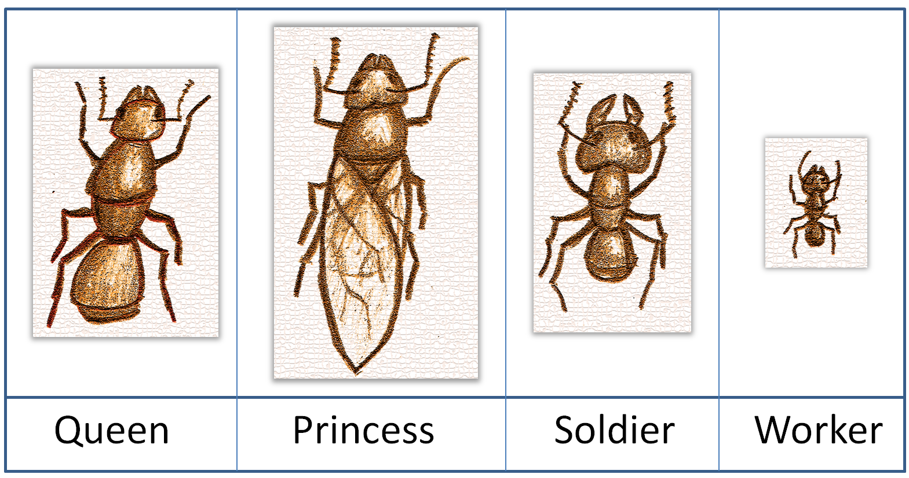
Problem Statement
Formica rufa (Red wood ant)

Slide 8

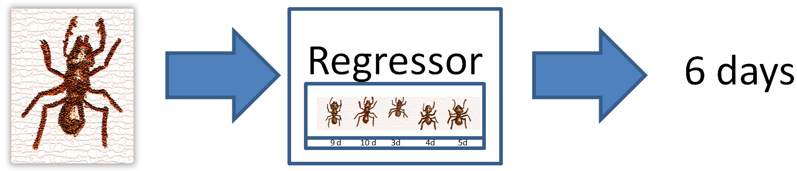
Classification vs. Regression

Slide 9
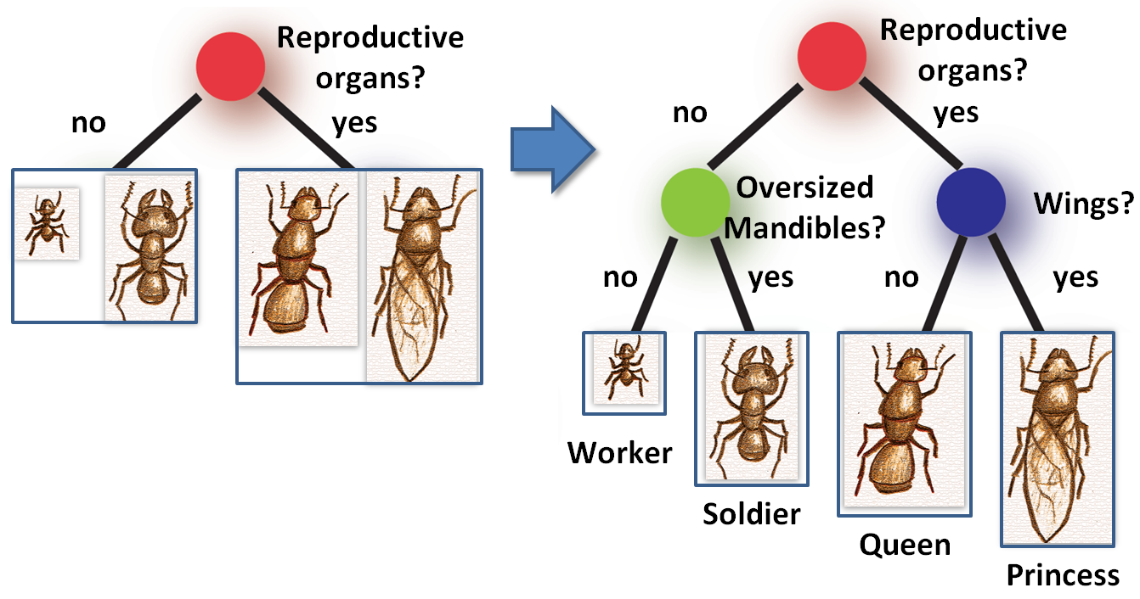
Decision Tree

Slide 10
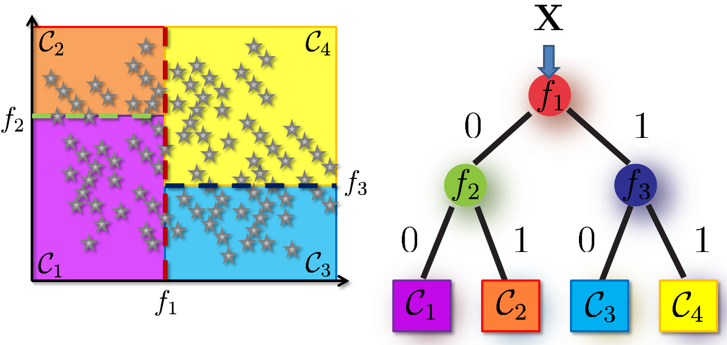
Forming a Decision Tree

Slide 11
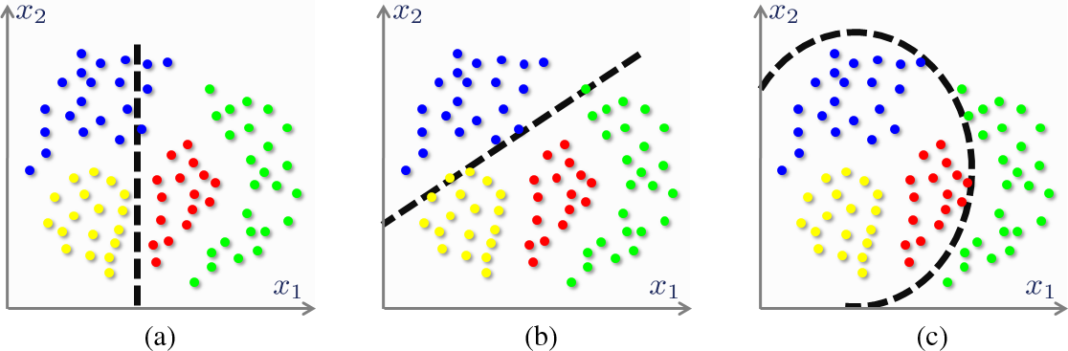
Step 1: Split Function at Node
Axis aligned split
Oblique split
Polynomial split

Slide 12
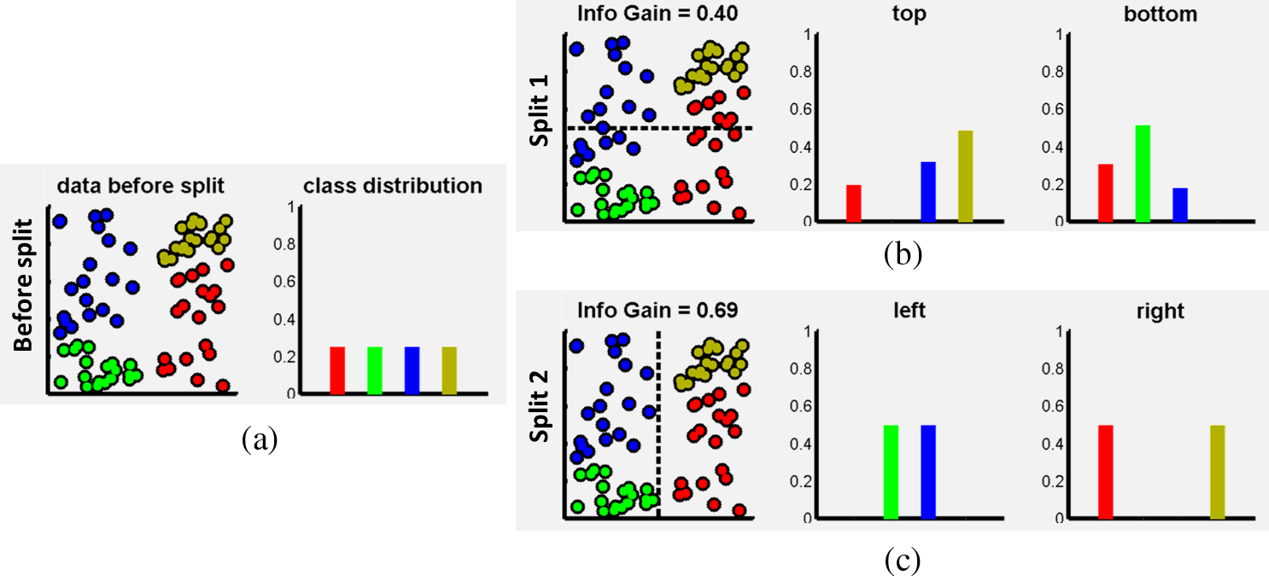
Step 2: Assessing Purity of Split

Slide 13
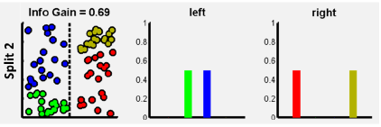
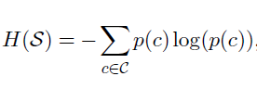
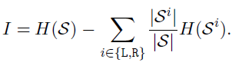
Cost function for Split Purity
Entropy of class distribution
Information Gain

Slide 14
Step 3: Selecting Optimum Split
Max. info. gain

Slide 15
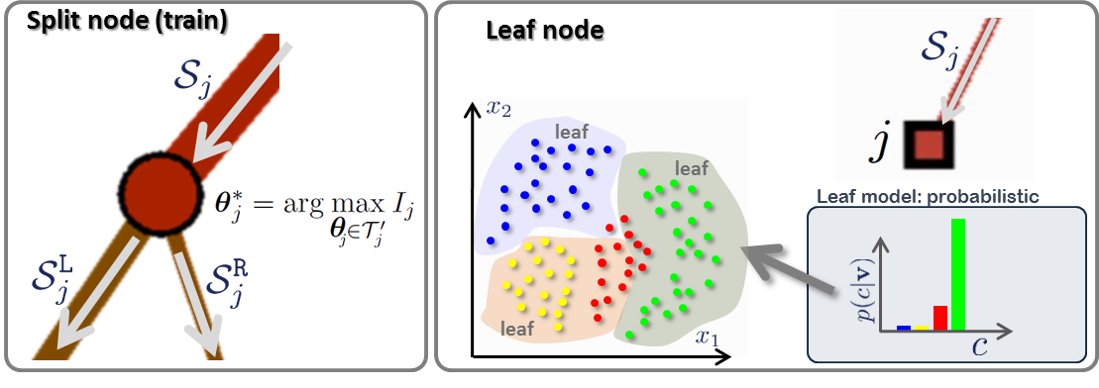
Step 4: Stopping Criteria

Slide 16
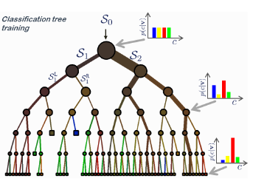
Step 5: Leaf Prediction Model

Slide 17
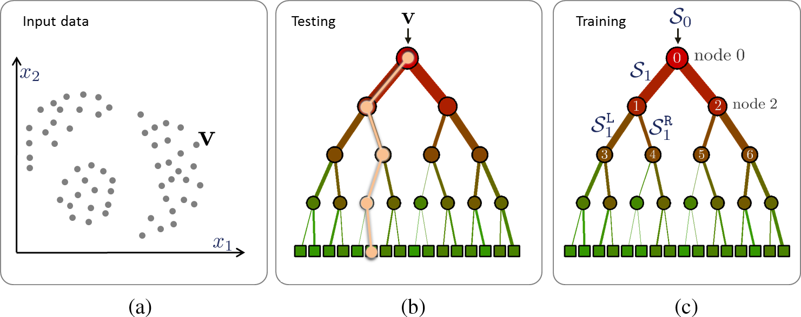
Deploying a Decision Tree

Slide 18
Random Forest

Slide 19
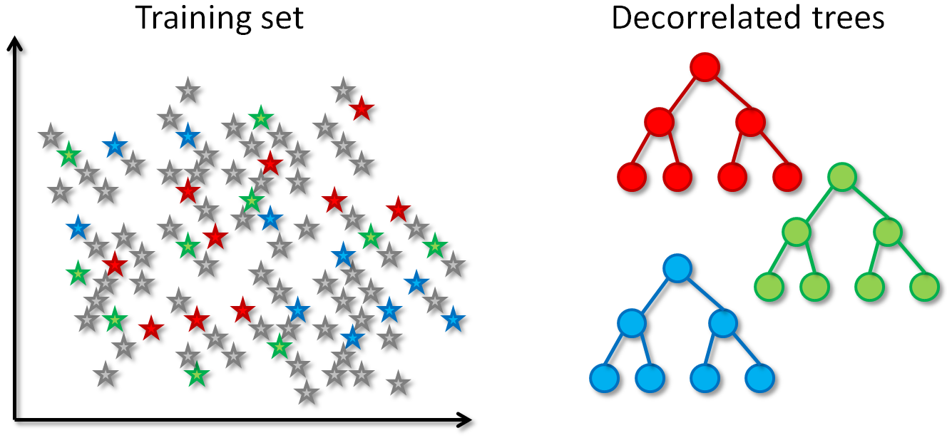
Growing Multiple Trees in a Forest
Bagging – Bootstrapped Aggregation

Slide 20
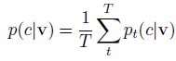
Ensemble Prediction Model

Slide 21
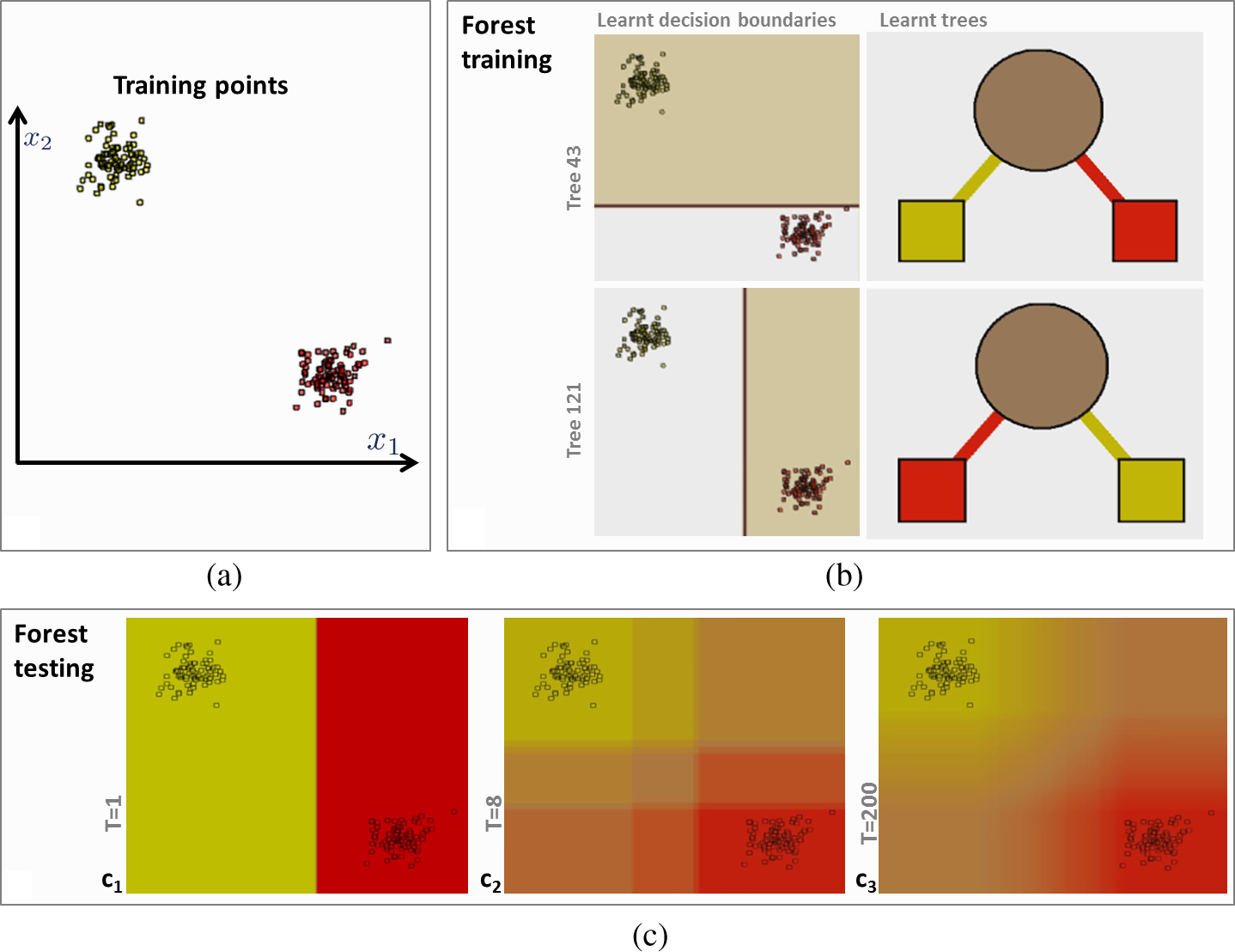
What do we gain by using a Forest?

Slide 22
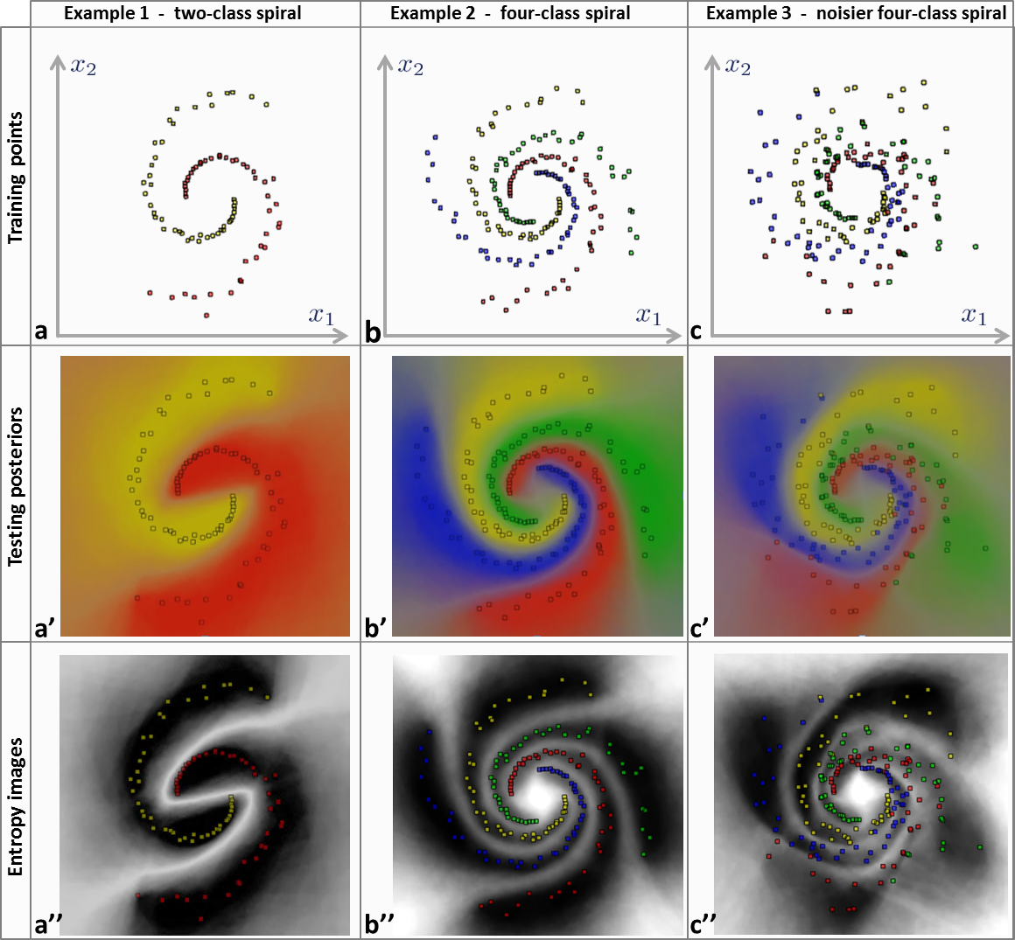
Noise Resilience and Topology Independence

Slide 23
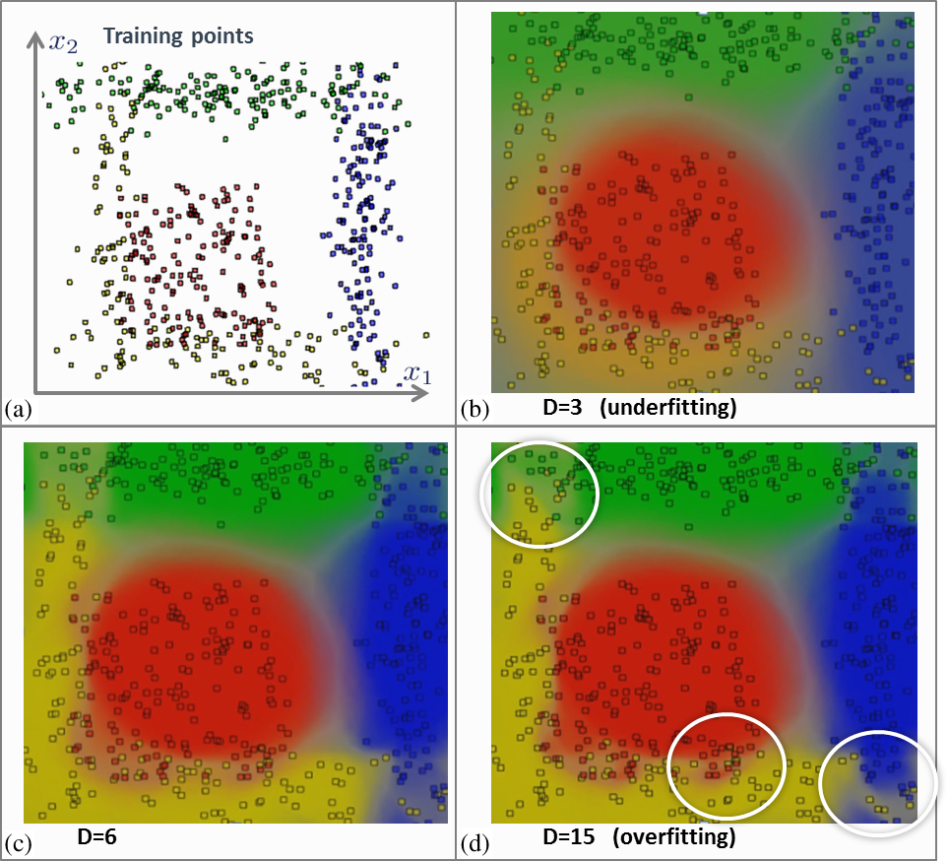
Effect of Tree Depth

Slide 24
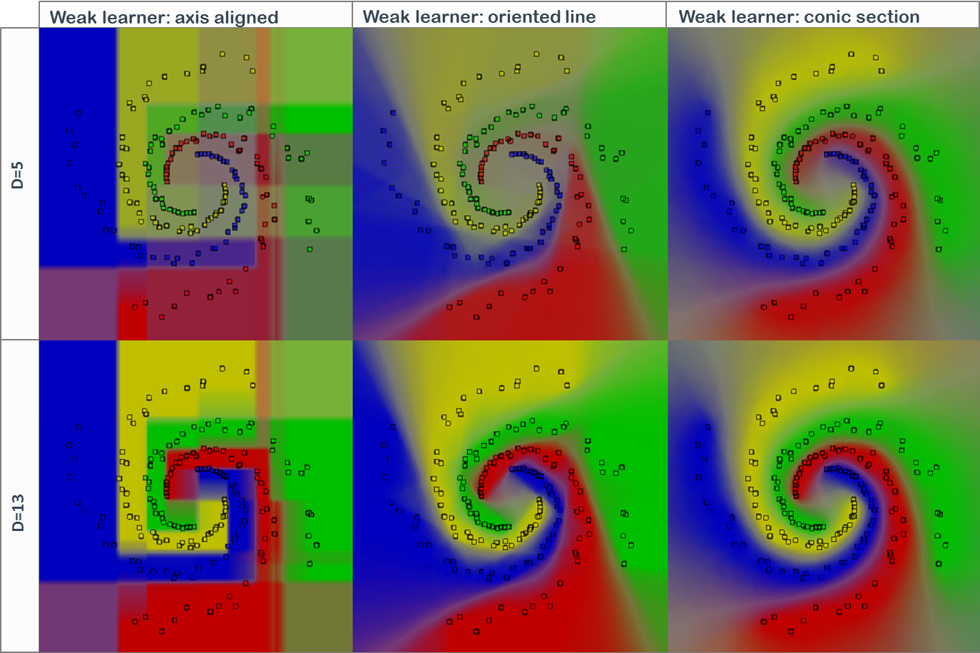
Effect of Split Function

Slide 25
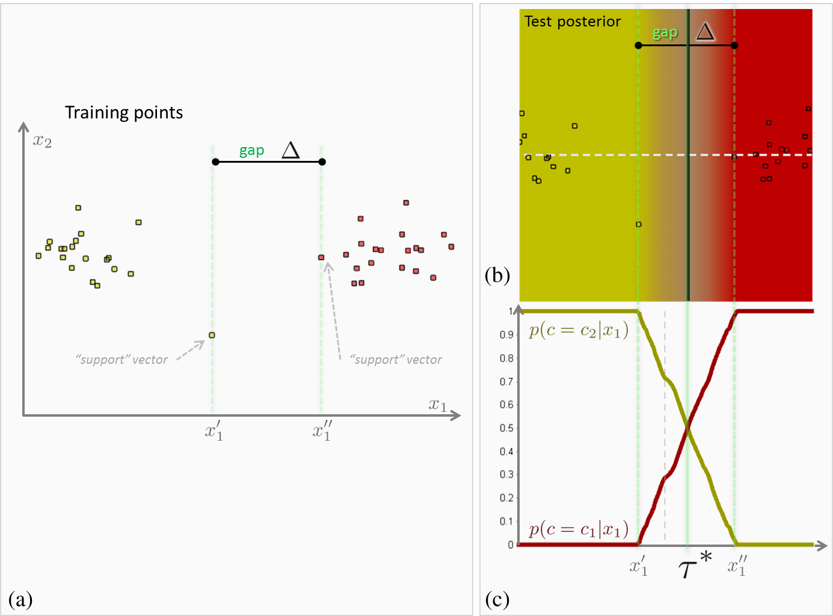
Classification Margin

Slide 26
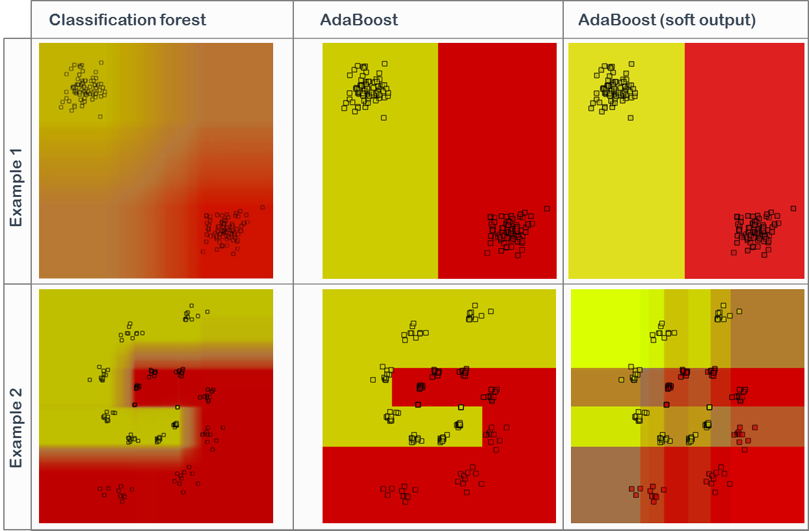
Random Forest vs. AdaBoost

Slide 27
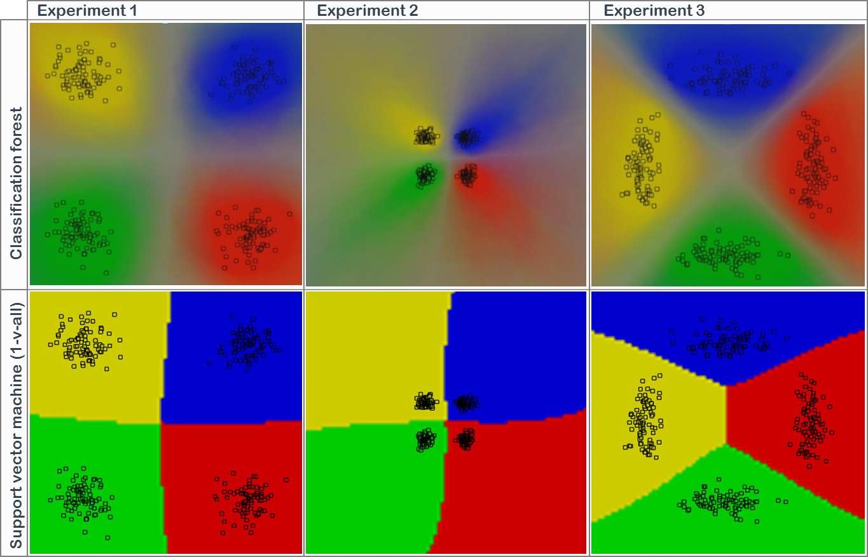
Random Forest vs. SVM

Slide 28
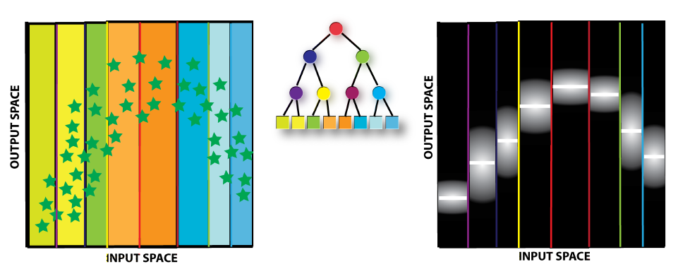
Regression Forest

Slide 29
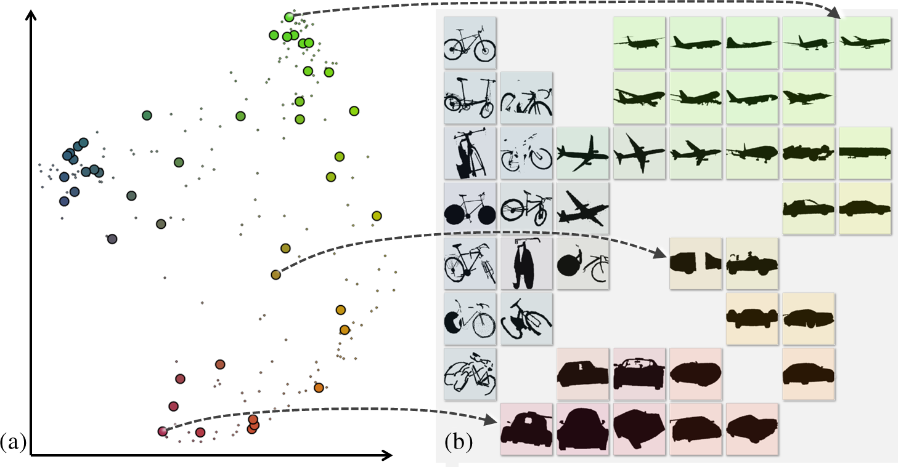
Manifold Forest

Slide 30
Application Scenarios
After the Brainstorming (Break)!

Slide 31
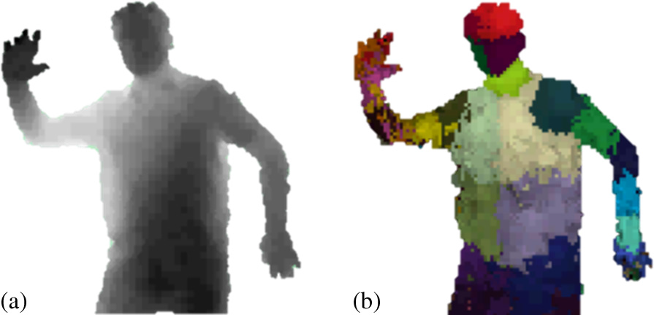
Gaming – Kinect for Xbox 360
Depth map
Body part classification
J. Shotton, A. Fitzgibbon, M. Cook, T. Sharp, M. Finocchio, R. Moore, A. Kipman, and A. Blake, “Real-time human pose recognition in parts from a single depth image,” in Proc. CVPR, 2011.

Slide 32
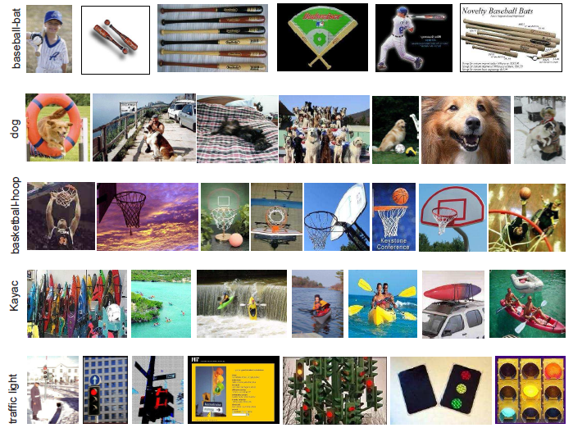
Vision – Scene Classification
Bosch, A., Zisserman, A., & Muoz, X. “Image classification using random forests and ferns”, ICCV 2007.

Slide 33
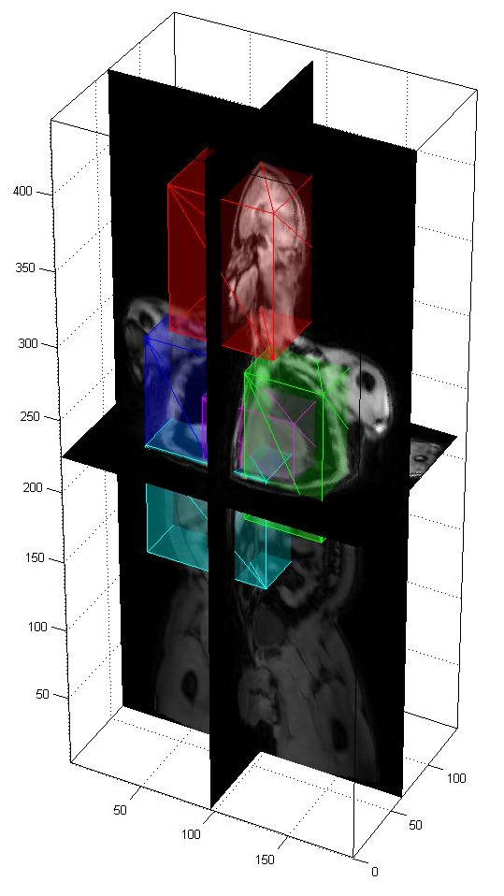
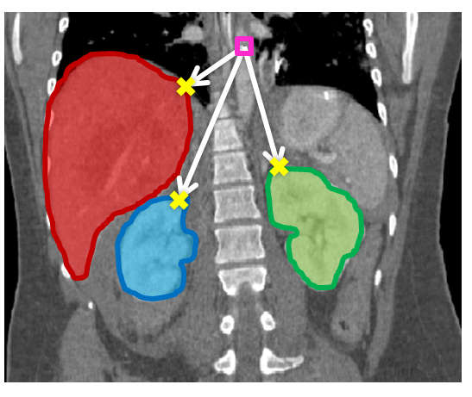
Medical – Digital Anatomy
A. Criminisi, D. Robertson, E. Konukoglu, J. Shotton, S. Pathak, S. White, and K. Siddiqui, ”Regression Forests for Efficient Anatomy Detection and Localization in Computed Tomography Scans”, Medical Image Analysis, 2013

Slide 34



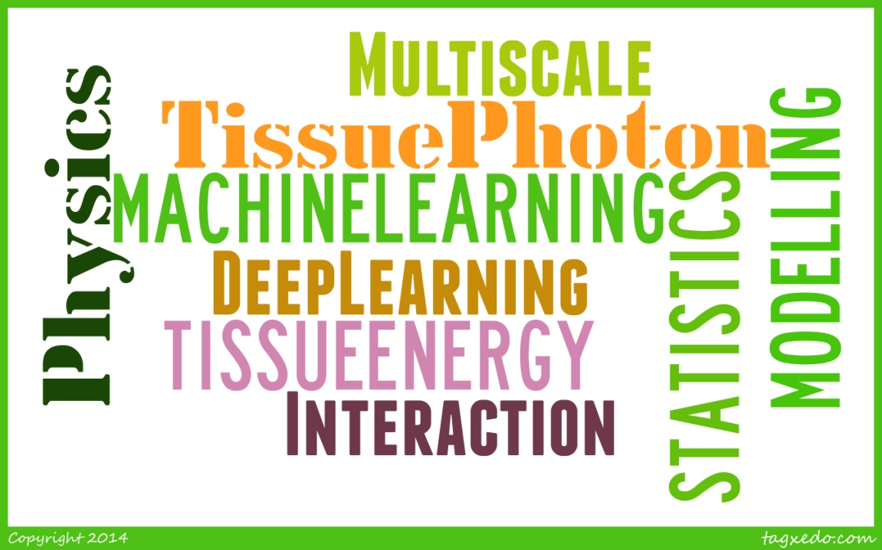

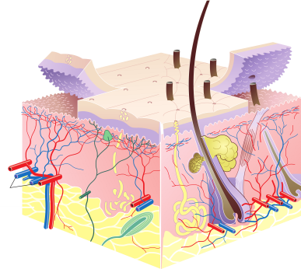
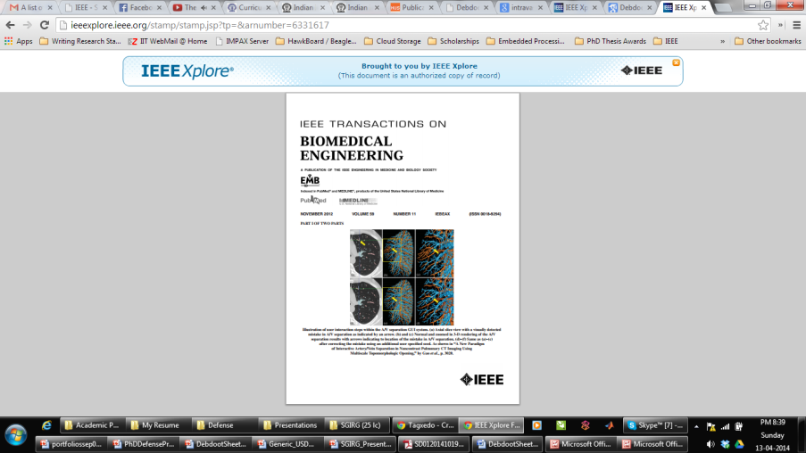
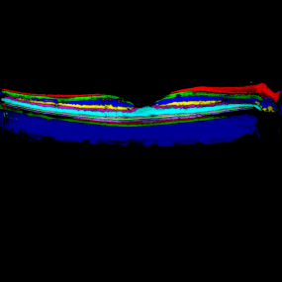
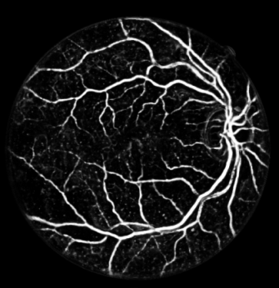

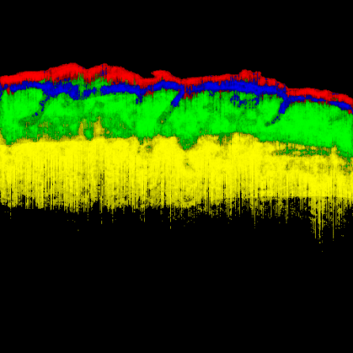
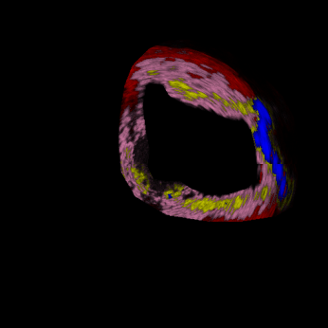
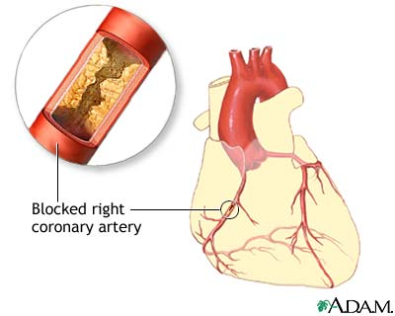
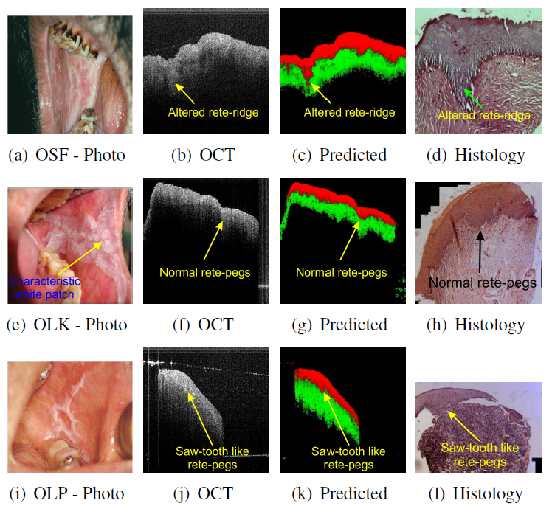
Medical – Computational Histology
D. Sheet et al., “Joint learning of ultrasonic backscattering statistical physics and signal confidence primal for characterizing atherosclerotic plaques using intravascular ultrasound”, Med. Image Anal,18(1), 2014
D. Sheet, et al, “In situ histology of mice skin through transfer learning of tissue energy interaction in optical coherence tomography”, J. Biomed. Optics, 18(9), 2013.
D Sheet, et al, “Detection of retinal vessels in fundus images through transfer learning of tissue specific photon interaction statistical physics”, Proc. Int. Symp. Biomed. Imaging (ISBI), 2013.
D. Sheet, et al., “Transfer Learning of Tissue Photon Interaction in Optical Coherence Tomography towards In vivo Histology of the Oral Mucosa”, Proc. Int. Symp. Biomed. Imaging (ISBI), 2014.
Hunting for necrosis in the shadows of intravascular ultrasound, CMIG, 38(2), 2014
K Basak and D Sheet et al., “Learning of Tissue Photon Interaction in Laser Speckle Contrast Imaging for Label-free Retinal Angiography”, Int. Symp. Biomed. Imaging (ISBI), 2014
SPK Karri and D Sheet et al., “Deep Learnt Random Forests for Segmentation of Retinal Layers in Optical Coherence Tomography Images”, Int. Symp. Biomedical Imaging (ISBI), 2014.
SPK Karri and D. Sheet, et al., “Computational Histology of Retina through Transfer Learning of Tissue Photon Interaction in Optical Coherence Tomography”, Proc. Int. Symp. Biomed. Imaging (ISBI), 2014.
D. Sheet, et al., “Iterative self-organizing atherosclerotic tissue labeling in intravascular ultrasound images and comparison with virtual histology”, IEEE TBME, 59(11), 2012

Slide 35
Engineering Design Perspective

Slide 36
Understanding Computations

Slide 37
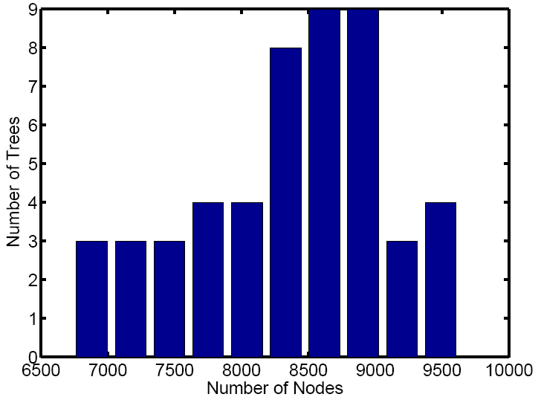
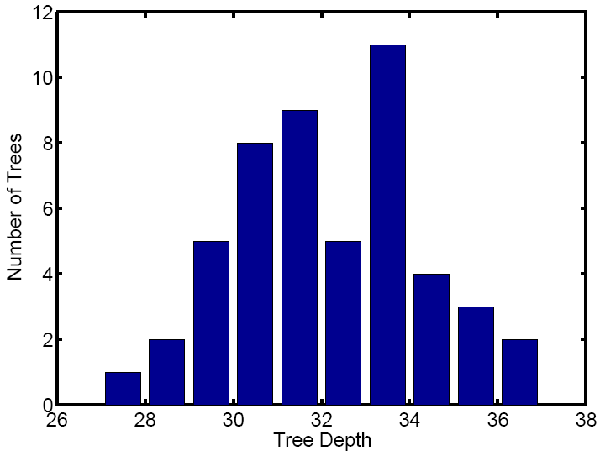
Computational Complexity
Training Complexity
Testing Complexity

Slide 38
Features and their Role
Feature 2
Feature 1

Slide 39
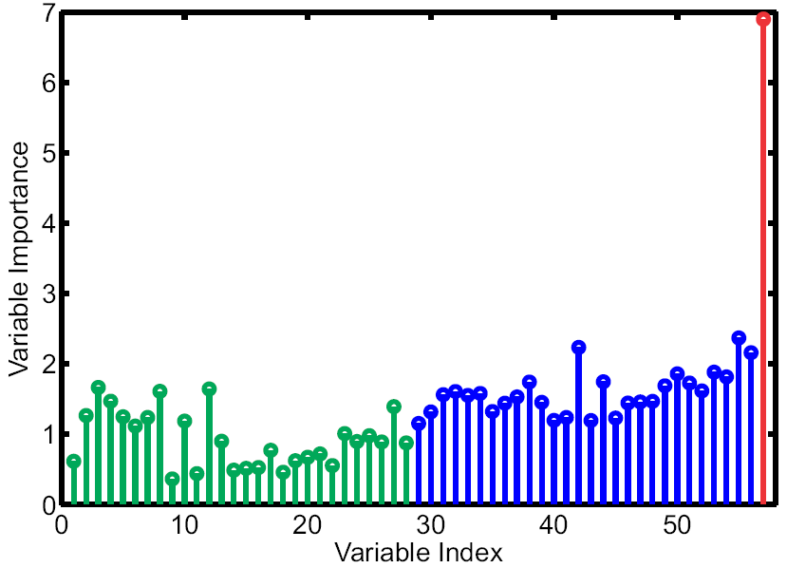
Variable Importance
Genuer, R., Poggi, J.-M., Tuleau-Malot, C., (2010). Variable selection using random forests. Pat. Recog. Letters. 31(14):2225-2236

Slide 40
What’s hot in research?

Slide 41
Research Challenges in 2015
Architecture
Online learning
Incremental learning
Long term memory
Parallel - distributed architectures
Split functions, cost functions, stopping criteria
Domain adaptation
Engineering and Application
Computational complexity
Statistics and Science
Consistency of forests
VC dimension
De-correlated trees

Slide 42
Take Home Message
Reading
L. Breiman, J. Friedman, C. J. Stone, and R. A. Olshen, Classification and Regression Trees. Chapman and Hall/CRC, 1984.
L. Breiman, “Random forests,” Machine Learning, vol. 45, no. 1, pp. 5–32, 2001.
A. Criminisi and J. Shotton, Decision Forests for Computer Vision and Medical Image Analysis, Springer, 2013.
Toolboxes and Packages
randomForest in R
TreeBagger in Matlab
sklearn.ensemble.RandomForestClassifier in Python-Scikit-learn
Conferences
Int. Conf. Comp. Vis. (ICCV)
Eur. Conf. Comp. Vis. (ECCV)
Asian Conf. Comp. Vis. (ACCV)
Comp. Vis. Patt. Recog. (CVPR)
Med. Image Comp., Comp. Assist. Interv. (MICCAI)

